Slide 1
Controlling COVID-19 Through
Indoor Humidity Management
with Graham Holmes, Dr. Stephanie Taylor, and Thomas Klein

Slide 2
Agenda
Time | Topic | Presenter
12:00 – 12:35 | Humidity and Health | Stephanie Taylor
12:35 – 12:50 | Condair Product Line – General Overview Adiabatic vs. Isothermal Overview of our stars: EL, RS, GS, ME, DL, HP, In-space adiabatic | Thomas Klein
12:50 – 12:55 | NEW Condair DA | Graham Holmes
12:55 – 1:00 | Summary & Q&A

Slide 3

Hello! I am happy to be here with you today
Stephanie Taylor, MD, M Arch
ASHRAE Distinguished Lecturer
Epidemic Task Group
Environmental Health Committee

Slide 4
Presentation Summary
The cloud of COVID–19 and a “silver lining”
This pandemic has rearranged our priorities
The built environment and health
Studies on Homo Indooris
Humans and microbes share many things
New studies bring humidification to the forefront
Buildings can and must support healthy occupants
Resistance to minimum humidity is high
Resolving misconceptions to move forward

Slide 5
Presentation Summary
The cloud of COVID–19 and a “silver lining”
This pandemic has rearranged our priorities
The built environment and health
Studies on Homo Indooris
Humans and microbes share many things
New studies bring humidification to the forefront
Buildings can and must support healthy occupants
Resistance to minimum humidity is high
Resolving misconceptions to move forward

Slide 6


My journey to you started around 1983

Slide 7

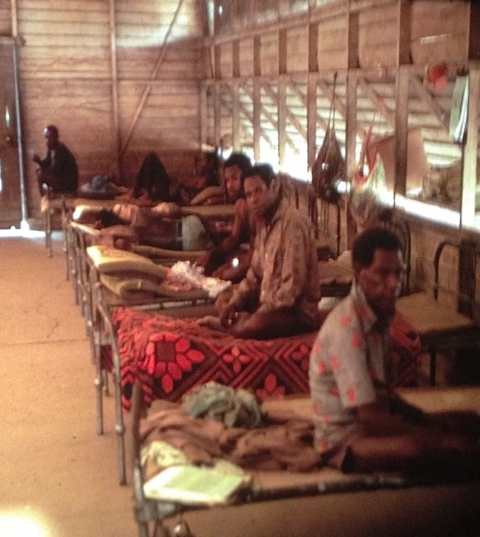

Non-hygienic hospital conditions, yet few infections
Wewack General Hospital, Papua New Guinea 1983

Slide 8

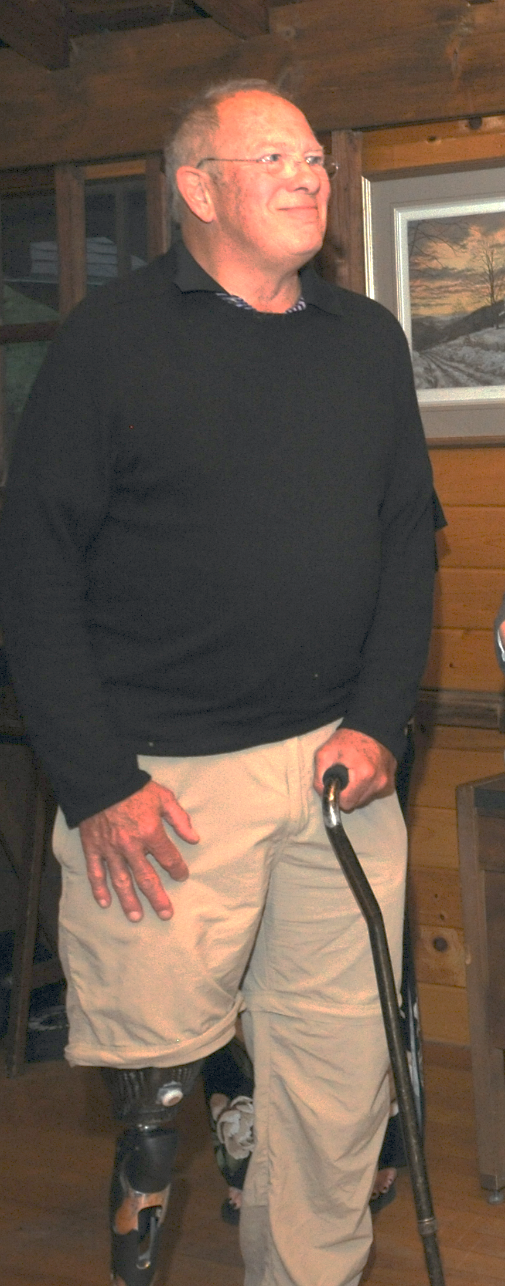

Yet, in N. America 1,700,000 patients/year get an infection from their hospitalization (HAI)
ADVERSE EVENTS = 393
Notes:
Classen, 2011‘Global Trigger Tool’ Shows
That Adverse Measured Events In Hospitals May Be Ten Times Greater
Than Previously

Slide 9

“Never underestimate the power of the environment!”
Harvard Medical School Chief-of-Surgery, Judah Folkman, M.D.
working with medical student, S. Taylor, 1986

Slide 10
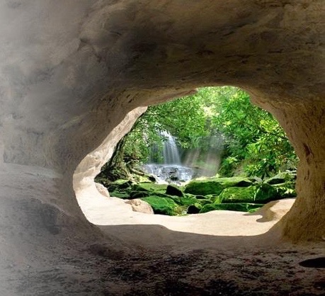
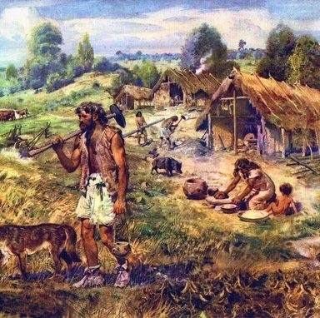
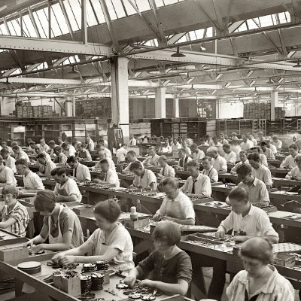



Our environment (90% indoors) has become very sophisticated
timeline: | 10,000 BC |  | 800 BC - 500 AC | 1900 AC | 2020
housing: | primitive housing, no sanitation systems |  | simple sanitation, in rural villages | industrial revolution: central sewage & water systems, heating, electricity | post-industrial cities, tighter buildings, dryer and warmer indoor air
infectious diseases: | parasites, zoonosis | 1st epidemics: small pox, measles, influenza, plague | 1st epidemics: small pox, measles, influenza, plague | 1st pandemic “Spanish flu” introduction of antibiotics & vaccines | Increasing infections, zoonotic transmis.,ABX-resistant bacteria
Notes:
Over more than350’000 year humans evolved parallel to the microbiome of outside world, the nature. They spent almost their whole lives in great proximity to nature.
In the last 200 to 300 years housing, lifestyle, population density and mobility changed dramatically!
Microbes could easily keep up with the changes, having a much greater adaptive capacity than human physiology.

Slide 11
However, many diseases have increased
timeline: | 10,000 BC |  | 800 BC - 500 AC | 1900 AC | 2020
housing: | primitive housing, no sanitation systems |  | simple sanitation, in rural villages | industrial revolution: central sewage & water systems, heating, electricity | post-industrial cities, tighter buildings, dryer and warmer indoor air
infectious diseases: | parasites, zoonosis | 1st epidemics: small pox, measles, influenza, plague | 1st epidemics: small pox, measles, influenza, plague | 1st pandemic “Spanish flu” introduction of antibiotics & vaccines | Increasing infections, zoonotic transmis.,ABX-resistant bacteria
Infectious diseases
Notes:
Over more than350’000 year humans evolved parallel to the microbiome of outside world, the nature. They spent almost their whole lives in great proximity to nature.
In the last 200 to 300 years housing, lifestyle, population density and mobility changed dramatically!
Microbes could easily keep up with the changes, having a much greater adaptive capacity than human physiology.

Slide 12
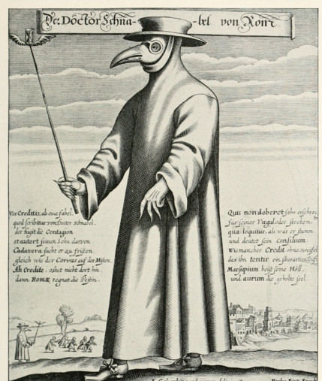
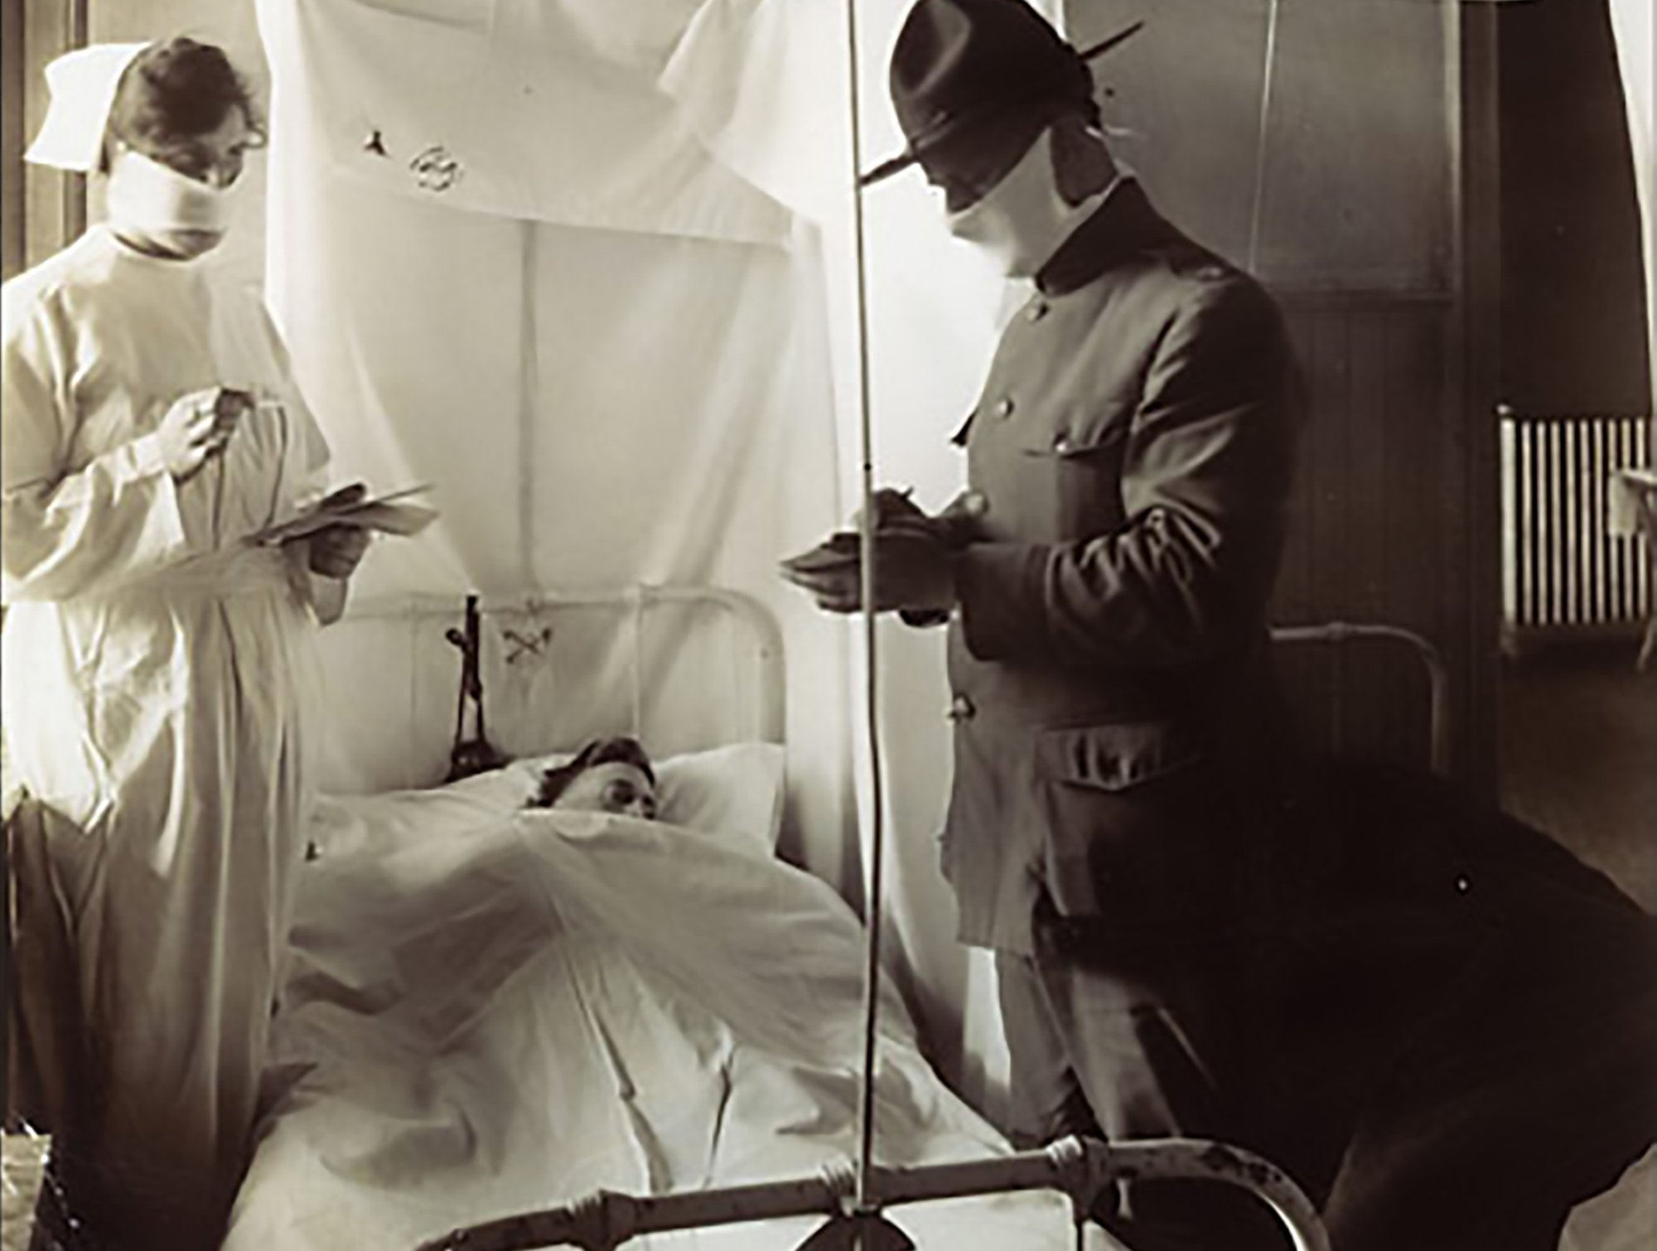
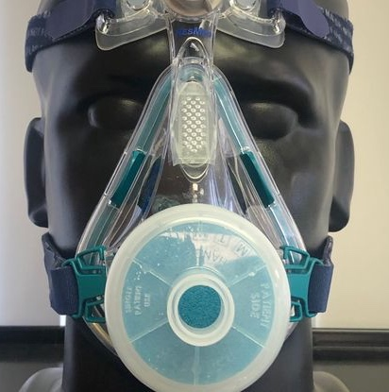
This is not the first, and will not be the last pandemic
Bubonic plague
1347
Spanish Influenza
1918
COVID-19
2020

Slide 13
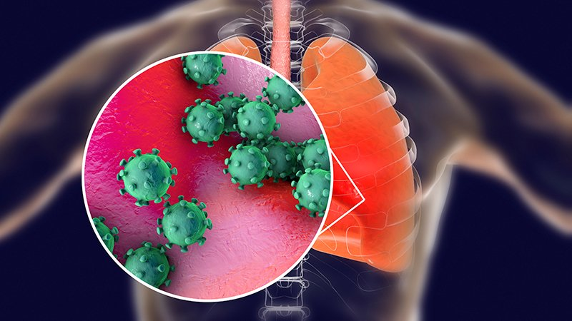
The COVID-19 virus mutated, allowing attachment to our deep lung tissues, and we have no immunological defenses from prior exposure

Slide 14
Presentation Summary
The cloud of COVID–19 and a “silver lining”
This pandemic has rearranged our priorities
The built environment and health
Studies on Homo Indooris
Humans and microbes share many things
New studies bring humidification to the forefront
Buildings can and must support healthy occupants
Resistance to minimum humidity is high
Resolving misconceptions to move forward

Slide 15
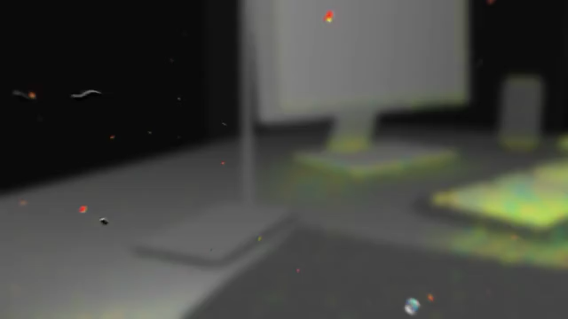
A closer look at ourselves indoors

Slide 16

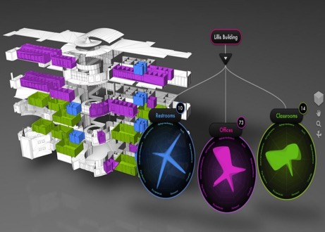
Survival of the fittest
Indoor environments determine which microbes will survive and interact with occupants
Occupants send their microbes into buildings
Notes:
Humans emit approx. 10^7 genome copies of bacteria, and 10^6 fungi into the air per person-hour, we inhale about one million per day
Kembel, S. W., Jones, E., Kline, J., Northcutt, D., Stenson, J., Womack, A. M., … Green, J. L. (2012). Architectural design influences the diversity and structure of the built environment microbiome. The ISME Journal, 6(8), 1469–79. http://doi.org/10.1038/ismej.2011.211

Slide 17
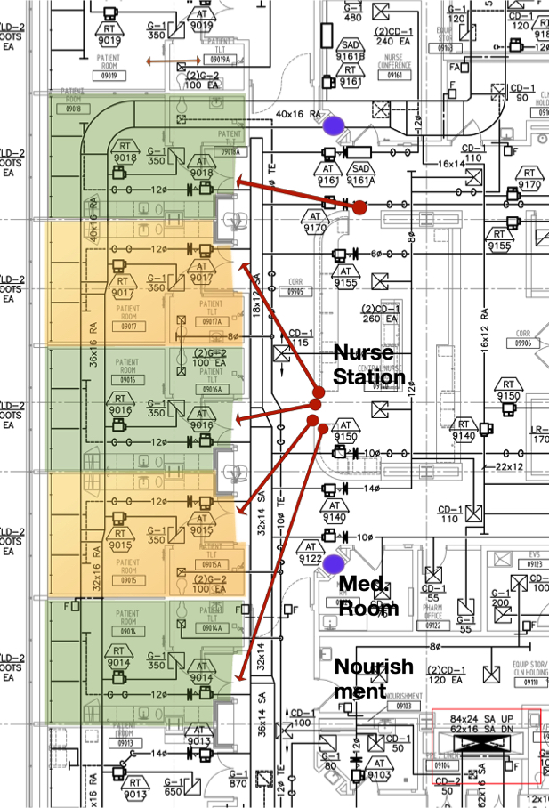

Do indoor factors contribute to infections?
Patient room data
VS.
Patient HAIs
Temperature
Staff & visitor hand cleaning
Room pressurization
Lux
CO₂ level
Relative humidity,
Absolute humidity
Room traffic
Outdoor air fractions
Room air changes
8 million room data points
~ 300 patient outcomes
Notes:
Built 2013, LEED Silver
1.2 million square feet
100,000 square feet per floor
240 single-occupancy inpatient rooms
52 ICU beds
28 ORs
Levels 8, 9, 10 - surgical, oncology and transplant patient rooms
Green roof
8 million data points on patient room environment!!
292 patients

Slide 18
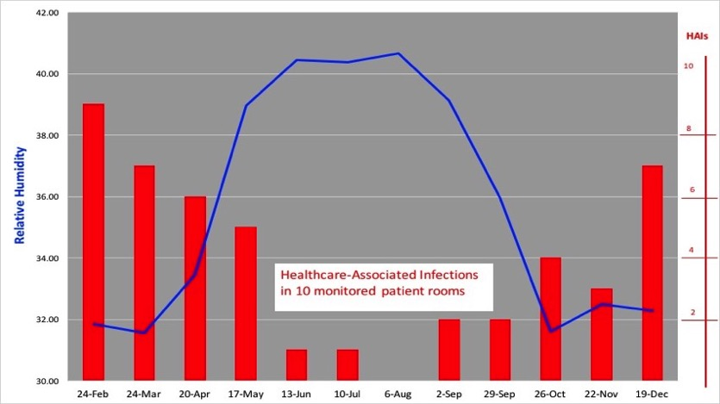
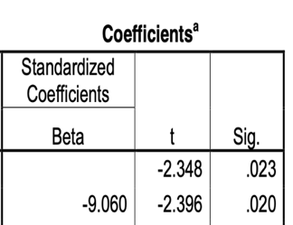
As patient room RH went down, infections went up!
Average RH for all patient rooms

Slide 19

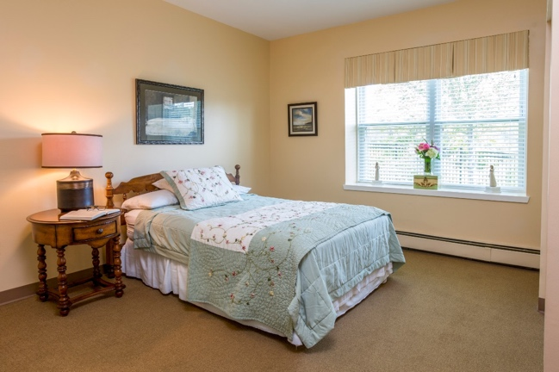

Indoor climate and health outcomes in residents in a long-term care facility (over 4 yrs)
Patient infections
VS
Environmental data
Infections
      respiratory (viral & bacterial)
      GI (Noro. & Notovirus, C. diff)
      urinary tract
      conjunctivitis
      cellulitis
Indoor factors
      temperature
      relative humidity
      visitors
      staff absenteeism
Outdoor factors
      temperature
      relative humidity
      flu outbreaks

Slide 20
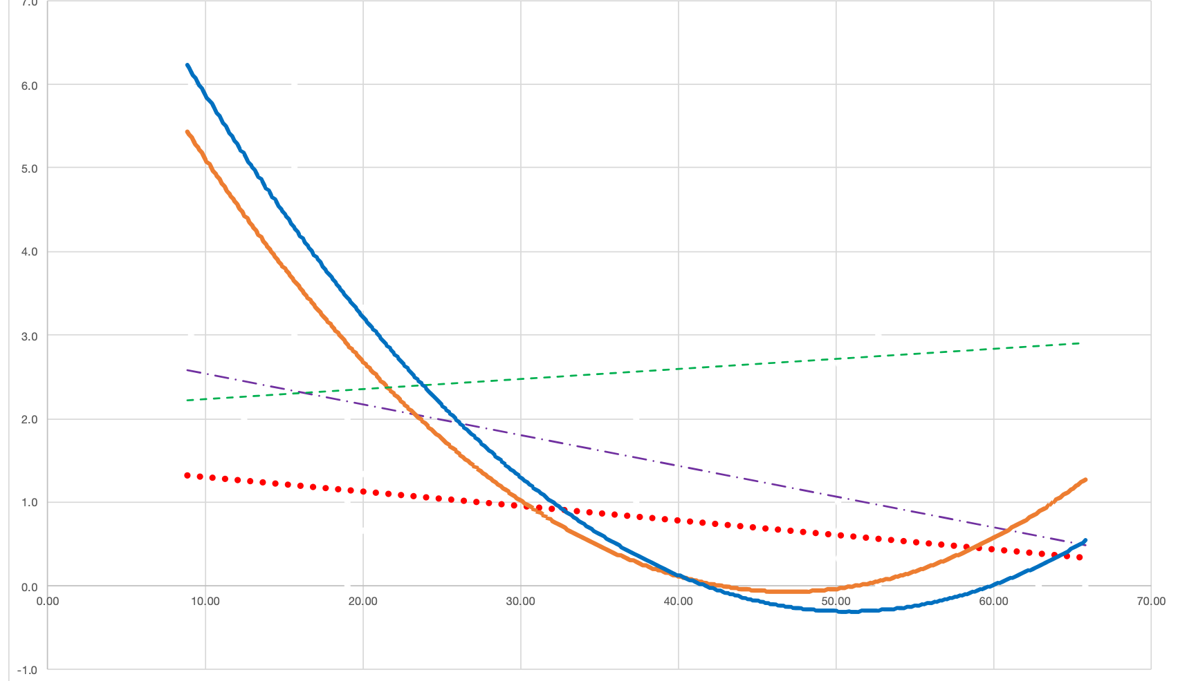
Infection rates were lowest when indoor RH = 40-60%
Respiratory
(bacterial & viral)
Gastrointestinal
(ex. Noro-virus, C diff)
Urinary tract infections
Cellulitis
Eye infections
avg # of infections
40 %
60 %
Indoor RH

Slide 21


2018: Humidity decreased Influenza A illness in a pre-school
January 25 – March 11 (32 days)
Half of the classrooms were humidified, the other half were not
RH of classrooms | % Airborne particles carrying virus (PCR) | Virulence of airborne virus | # children absent due to influenza illness
20% | 49% | 75% | 22
45% | 19% | 35% | 9
Notes:
Reiman JM, Das B, Sindberg GM, Urban MD, Hammerlund MEM, Lee HB, et al. (2018) Humidity as a non-pharmaceutical intervention for influenza A. PLoS ONE 13(9): e0204337. https:// doi.org/10.1371/journal.pone.0204337

Slide 22
There are 3 possible steps where we can intercept the spread of COVID-19 disease
1.
2.
3.
Behaviors
Indoor air and surface “cleanliness”
Increase health and immunity

Slide 23

What determines if this cough will infect others?

Slide 24



Pathogen infectivity is high when RH < 40%
Greater aerosol transmission
Evasion from surface cleaning through resuspension
Increased survival and virulence of pathogens

Slide 25
Infectious droplets shrink, travel far and evade surface cleaning when the air is dry
Droplet diameter in microns (um)
Float time
1
0.5
41 hours – 21 days
3
10
1.5 hours
100
6 seconds
Distance travelled:
1m
10m+

Slide 26
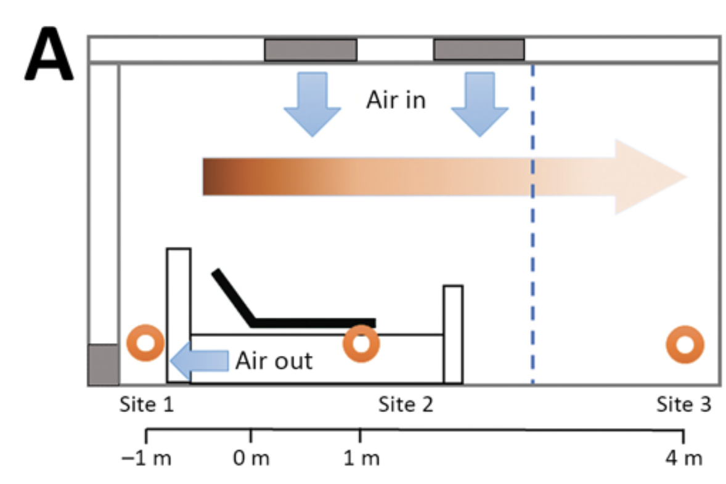
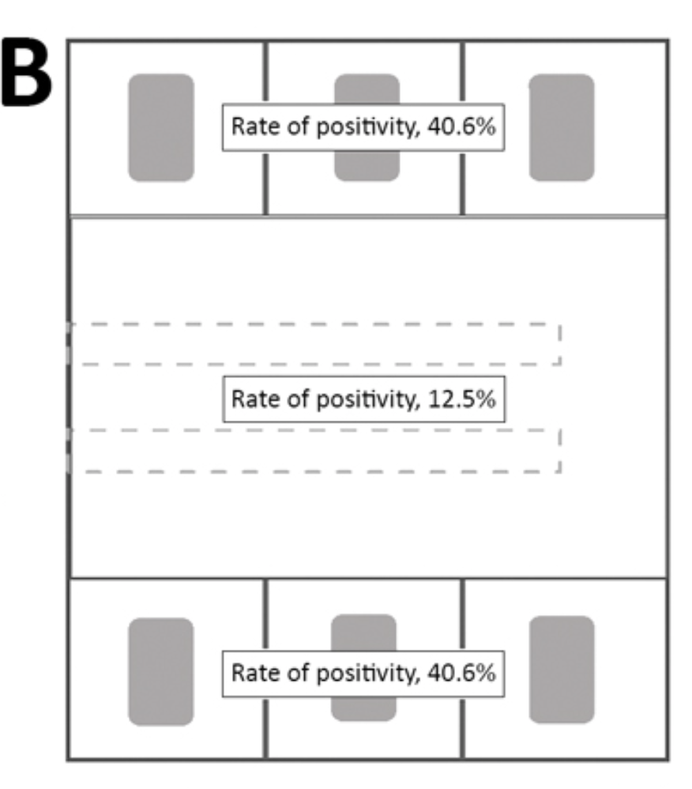
The air and surfaces in Wuhan ICU with COVID-19 were widely contaminated by SARS-CoV-2 up to 14 feet away
Guo Z-D, Wang Z-Y, Zhang S-F, Li X, Li L, Li C, et al. Aerosol and surface distribution of severe acute respiratory syndrome coronavirus 2 in hospital wards, Wuhan, China, 2020. Emerg Infect Dis. April 10.

Slide 27
Influenza A virus is more infectious when RH is below 40%
Highly infectious
Virus-Viability (%)
Non-infectious
Noti 2007
RH (%)

Slide 28
Humidification to 50% RH reduces the viable Coronavirus to less than 1% in 2 days, significantly decreasing the infection risk (blue line).
100
10
1
0.1
0.01
RH 20% , T 20°C
inactivation log₁₀ - 0.081/day
viable viruses [%]
RH 80% , T 20°C
inactivation log₁₀ - 0.212/day
RH 50% , T 20°C
inactivation log₁₀ - 0.896/day
1 2 3 4 5 6 7 8 9 10 11 12 13 14 days
Notes:
Casanova LM et al, Effects of Air Temperature and Relative Humidity on Coronavirus Survival on Surfaces, APPLIED AND ENVIRONMENTAL
MICROBIOLOGY, May 2010, p. 2712–2717

Slide 29
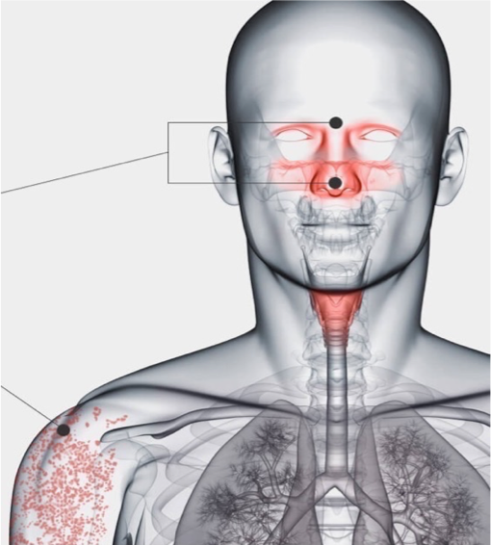
Conversely, humans suffer in low RH
  Sitting in room air with 20% RH, the average person becomes clinically dehydrated in 8 hours
Brain
decreased function
fatigue
anxiety, depression
Eyes
dry eyes
blurry vision
corneal inflammation
Respiratory tract
infections
allergies
asthma
Skin
dryness, cracking
dermatitis
auto-immune disease

Slide 30
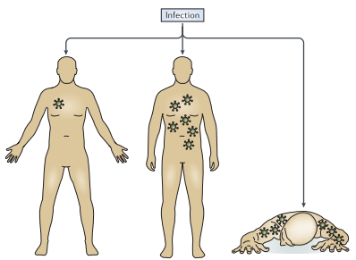
Low ambient humidity impairs barrier function and innate resistance against influenza infection
Kudo, et al. 2019. Proceedings of the National Academy of Sciences, USA. May 19.
RH 50%
RH 50%
This study was done in genetically engineered mice
RH 20%
Gets rid of the virus
Gets a little sick
Gets VERY sick

Slide 31
All of these protective mechanisms are impaired at RH 20% and are optimal at 50% RH
Improved muco-ciliary clearance
Enhanced protection induced by Interferon
Decreased inflammation and tissue damage
Enhanced tissue
repair

Slide 32
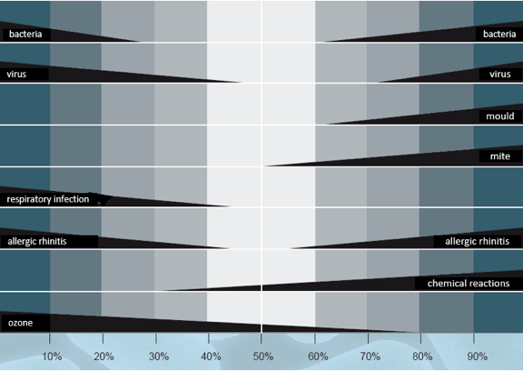
ASHRAE 1985:“Optimal RH Level For Health” = 40%–60%
Notes:
Sterling, Avundel, Sterling 1985

Slide 33
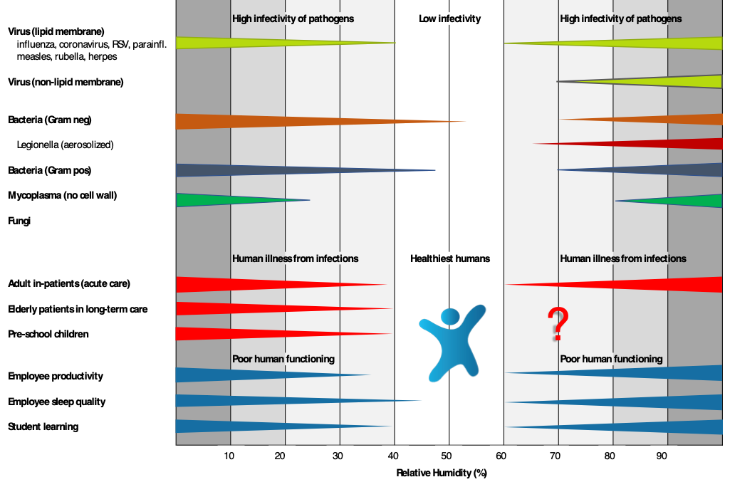
Taylor Chart 2019

Slide 34
Presentation Summary
The cloud of COVID–19 and a “silver lining”
This pandemic has rearranged our priorities
The built environment and health
Studies on Homo Indooris
Humans and microbes share many things
New studies bring humidification to the forefront
Buildings can and must support healthy occupants
Resistance to minimum humidity is high
Resolving misconceptions to move forward

Slide 35
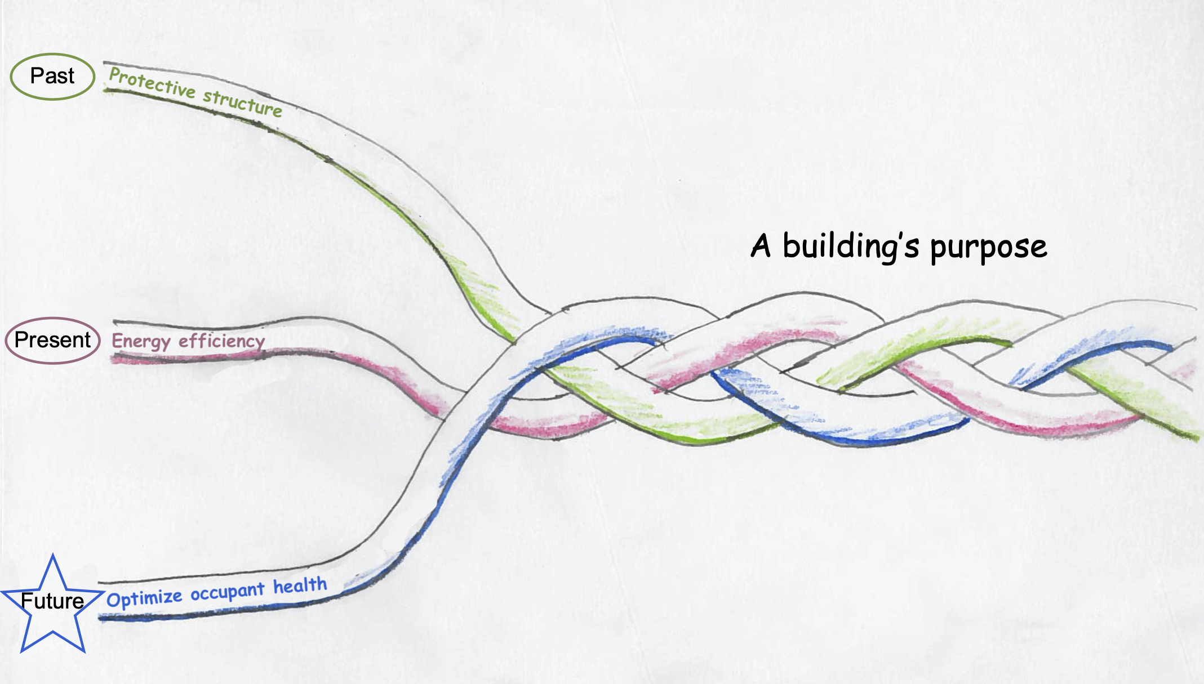
The future of building design and operation

Slide 36
RH 40–60% supports two of the three steps in decreasing disease transmission
1.
2.
3.
Behaviors
Indoor air and surface “cleanliness”
Increase health and immunity

Slide 37
RH maintained 40–60% effectively accomplishes two tasks
1.
Decreases the burden of infectious COVID-19 virus:
Decreases number of airborne infectious aerosols in our breathing zone
Optimizes social distancing by limiting spread of virus in airborne droplets
Decreases the actual infectivity of SARS-CoV-2 virus in airborne aerosols and surface particles
Optimizes hand and surface cleaning by decreasing resuspension and resettling

Slide 38
RH maintained 40–60% effectively accomplishes two tasks
2.
Supports the health of building occupants:
RH 40–60% is immune-supportive to our respiratory tract and skin natural defenses
Decreased tissue levels of the immuno-suppresant cortisol
Improved sleep, decreased daytime fatigue and increased overall health

Slide 39
Indoor RH 40–60% will correct this trend
timeline: | 10,000 BC |  | 800 BC - 500 AC | 1900 AC | 2020
housing: | primitive housing, no sanitation systems |  | simple sanitation, in rural villages | industrial revolution: central sewage & water systems, heating, electricity | post-industrial cities, tighter buildings, dryer and warmer indoor air
infectious diseases: | parasites, zoonosis | 1st epidemics: small pox, measles, influenza, plague | 1st epidemics: small pox, measles, influenza, plague | 1st pandemic “Spanish flu” introduction of antibiotics & vaccines | Increasing infections, zoonotic transmis.,ABX-resistant bacteria
Indoor air hydration to RH 40–60%
Infectious diseases
Notes:
Over more than350’000 year humans evolved parallel to the microbiome of outside world, the nature. They spent almost their whole lives in great proximity to nature.
In the last 200 to 300 years housing, lifestyle, population density and mobility changed dramatically!
Microbes could easily keep up with the changes, having a much greater adaptive capacity than human physiology.

Slide 40

Thank you!
Stephanie Taylor, M.D., M. Arch., ASHRAE DL
Harvard Medical School, Primary Care
CEO Taylor Healthcare Consulting
e-mail: MD@taylorcx.com
phone: (860) 501-8950
Thank you to my colleague,
Walter Hugentobler, MD
and Luigi!

Slide 41
Partial Bibliography
Gibbons SM. 2016, The built environment is a microbial wasteland, mSystems 1(2):e00033-16. d
Kembel SW, 2012, Architectural design influences the diversity and structure of the built environment microbiome, The ISME Journal (2012) 6, 1469–1479
Stone W et al, 2016, Microbes at Surface-Air Interfaces: The Metabolic Harnessing of Relative Humidity, Surface Hygroscopicity, and Oligotrophy for Resilience, frontiers in Microbiology 7:1563. doi: 10.3389/fmicb.2016.01563
Ebinesh A, 2017, Conspiracy of domestic microenvironment, bacterial stress response and directed mutagenesis towards antimicrobial resistance: Lessons for health care. J Infectious Disease Med Microbiol. 2017;1(1):1-3.
Helsinki alert of biodiversity and health, Annals of Medicine, 2015
Vandegrift R et al, 2017, Cleanliness in context: reconciling hygiene with a modern microbial perspective, Microbiome (2017) 5:76
Chopra A, Lineweaver, 2016, The Case for a Gaian Bottleneck: The Biology of Habitability, ASTROBIOLOGY, Volume 16, Number 1, 2016
Goffau MC et al, 2009, Bacterial pleomorphism and competition in a relative humidity gradient, Environmental Microbiology (2009) 11(4), 809–822
Kramer A et al, 2006, How long do nosocomial pathogens persist on inanimate surfaces, a systematic review, BMC Infectious Diseases 2006, 6:130
Noti JD et al. 2013. Higher Humidity Leads to Loss of Infectious Virus from Simulated Coughs. University of Illinois.
Tropical Medicine & International Health. 2008., Volume 13, Issue 12, pages 1543-1552, 6 Oct.
Sterling EM et al. 1985. Criteria for Human Exposure to Humidity in Occupied Buildings. ASHRAE Transactions. Vol. 91. Part 1.
Fuchsman et al. 2017. Effect of the environment on horizontal gene transfer between bacteria and archaea . PeerJ 5:e3865; DOI 10.7717/peerj.3865.
Donovan TL et al. 2008. Employee absenteeism based on occupational health visits in an urban tertiary care Canadian hospital. Public Health Nursing 25(6), 565-575.

Slide 42


Isothermal vs Adiabatic
Isothermal
Adiabatic
Gas Steam
Electric Steam
Resistive Element
Live Steam
Evaporative Media
Nozzles
High Pressure
Steam
Evaporation
Isothermal – involving or possessing a constant temperature. (We add energy. Air temp stays the same.)
Adiabatic – relating to or denoting a process or condition in which heat does not enter or leave the system concerned. (Air temp changes. No energy added.)

Slide 43
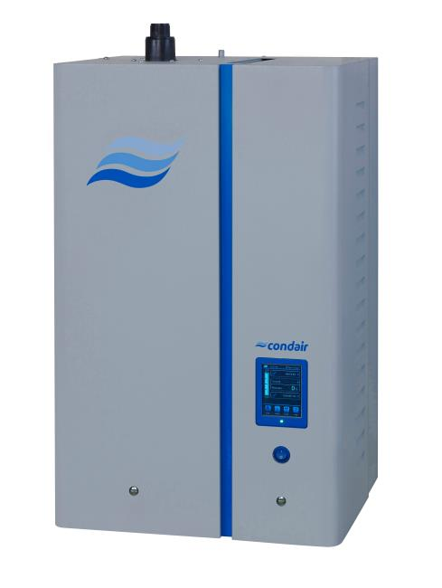
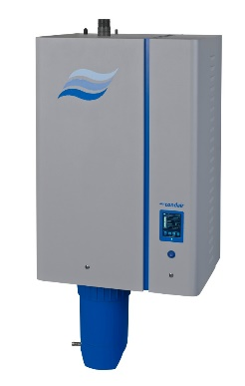
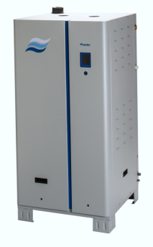
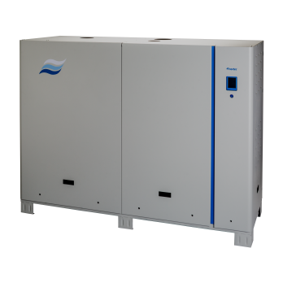
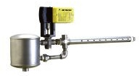
Condair’s Humidification Product Line
Steam Generation
Electrode
Resistive
Gas
Central Steam
Livesteam
Steam-to-steam
EL Series
RS Series
GS Series
LS Series
SE Series

Slide 44
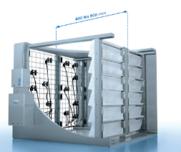
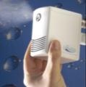
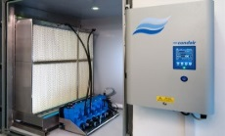

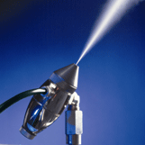
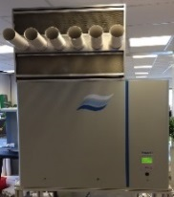
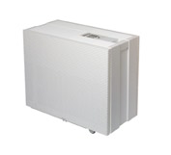
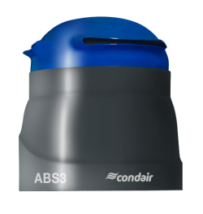
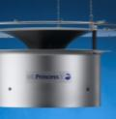
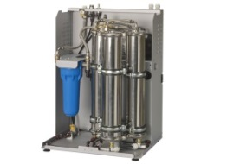

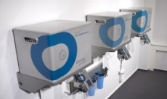
Condair’s Humidification Product Line
Atomization/Evaporation
HVAC (duct application)
Direct Systems (direct room application)
Evaporators
High pressure nozzle systems
Hybrid
(low pressure & evaporation)
High pressure nozzle systems
Compressed air nozzle systems
Rotary disk atomizers
Ultrasonic nebulizers
Mobile evaporators
ME Series
HP Series
DL Series
Draabe
ML System
JetSpray
ABS
UN Series
B500
Water Treatment Systems (reverse osmosis)
ML
System
Draabe new
generation
RO-A

Slide 45
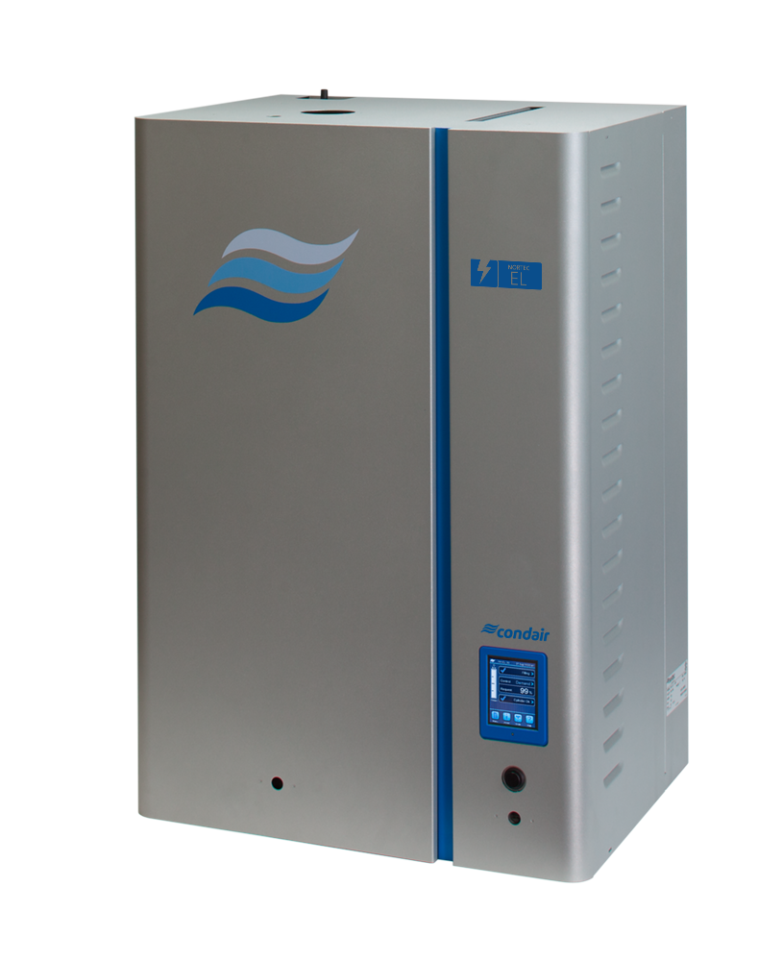
Nortec EL
Nortec EL launched in January 2016 replacing existing NH-EL
NHTC, NHPC, NHMC, etc. legacy models
Capacities from 5 lbs/h to 200 lbs/h
Feature | Benefit
Cylinder | Easy maintenance, brings humidifier performance back to brand new
Touch screen integrated controller | Full control over the humidifier, BMS integration
OSHPD certification | Seismically safe

Slide 46
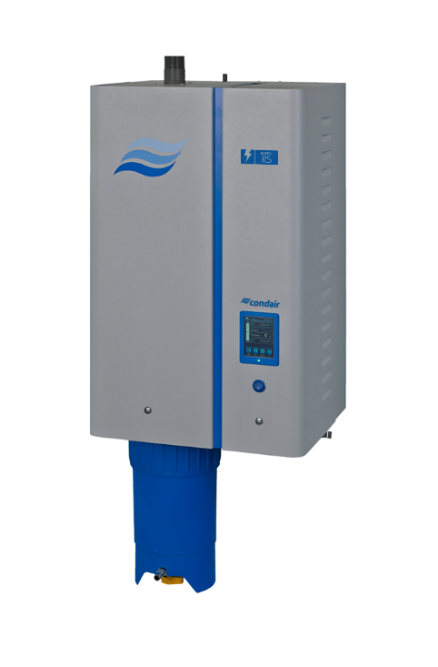
Nortec RS
Nortec RS has been launched since August 2015
Resistive element sales have increased significantly since the launch
Capacities from 10 lbs/h to 180 lbs/h
Feature | Benefit
Resistive elements | no dependency on water (De-ionized, Reverse Osmosis, potable)
Touch screen integrated controller | Full control over the humidifier, BMS integration
SSR option | unit is able to achieve +/- 1% RH
Scale Management | reduced maintenance

Slide 47
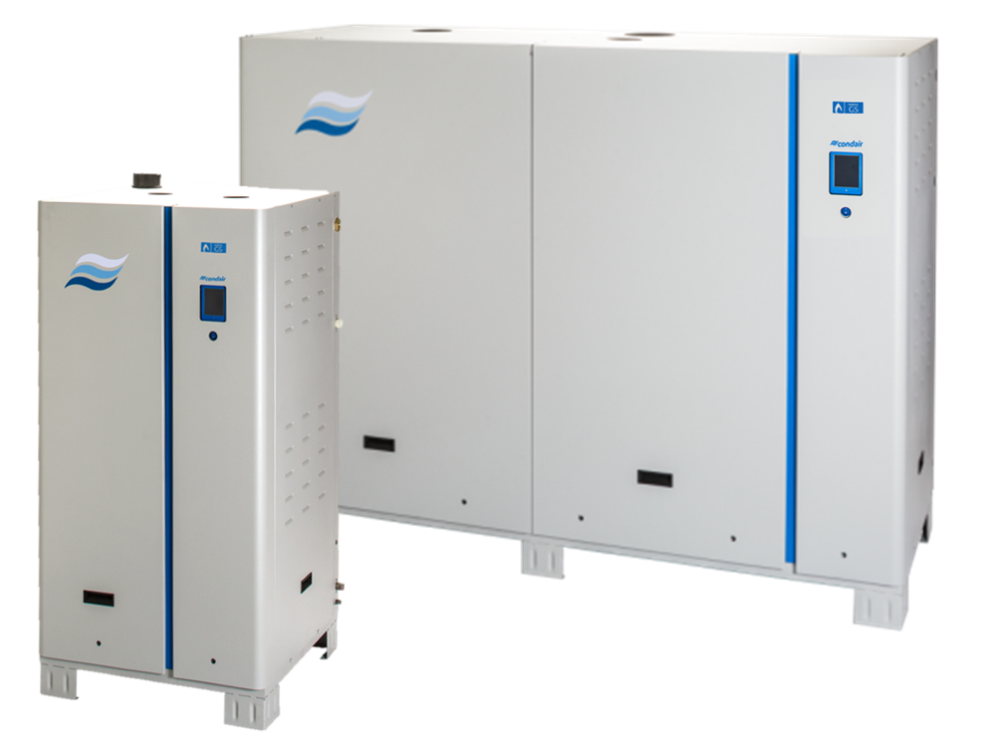
Nortec GS
Nortec GS launch Series 2 is newly launched (2020)
First secondary heat exchanger humidifier on the market
Available in 3 different options: CS, NX, MT
Capacities from 50 lbs/h to 600 lbs/h
Feature | Benefit
Secondary Heat exchanger | Up to 93% efficient (GS CS)
Touch screen integrated controller | Full control over the humidifier, BMS integration
Low NOx available | Reduced GHG emissions
New Exhaust Options | CPVC venting, BH venting, sealed combustion standard, all available for the CS

Slide 48
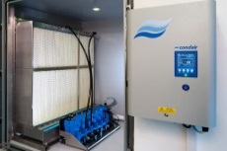





Nortec ME, HP, DL
Evaporators
High Pressure nozzles
Hybrid
+ Compact
+ Easy to install & use
+ Affordable
+ No need of RO water
+ Regulation
+ Efficiency (if enough humid. distance)
+ No recirculation
+lower total cost for mult. AHU
+ Efficiency
+ Aerosol free
+ No wear
+ Maintenance
+ No recirculation
- Poor Regulation
- Maintenance/Spares
Possibility of aerosols
Waste water (if not enough absorp. distance)
Wearing
Installation time

Slide 49
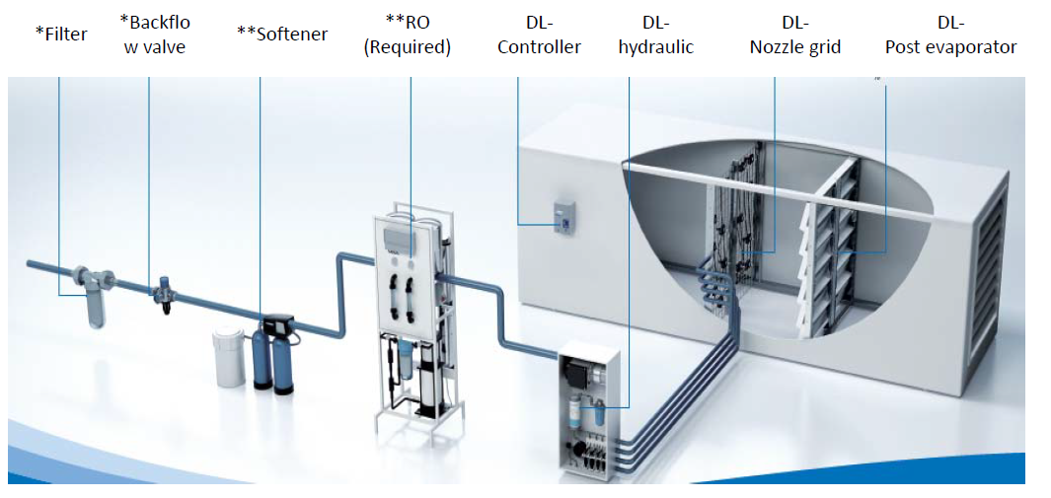
Nortec DL
*Backflow valve
*Provided by Others **Optional

Slide 50
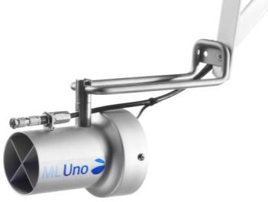
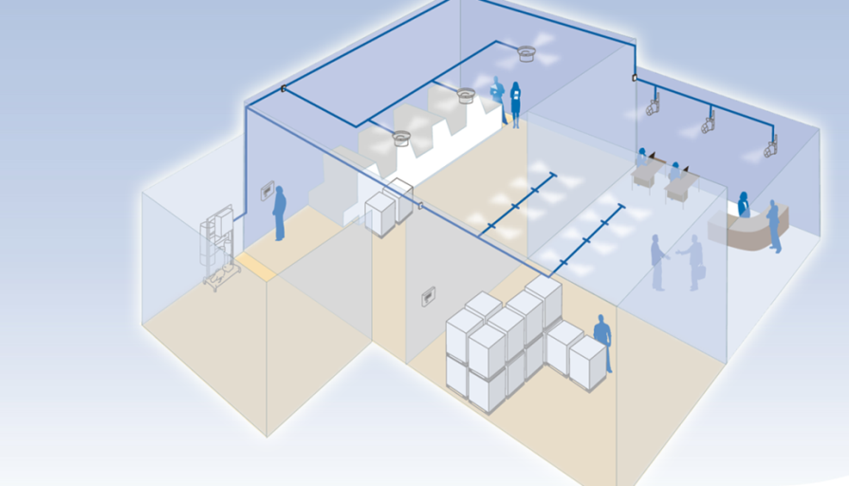
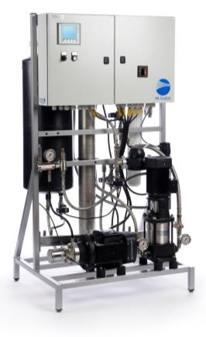
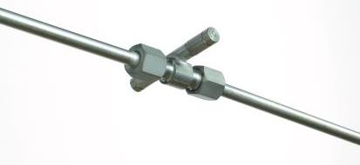
ML Series
No compromise on components
  Danfoss oil free high pressure pump
  Stainless steel valves, fittings and couplings
Tailor made for any application
  Variant configuration of pre-defined modules
  Custom project design (Optional)
Long time robustness and reliability
  Designed for industrial application
Also for dust intolerant applications
No compromise on hygienic safety
    Bureau Veritas Quality International
    ISO 22000/HACCP certified
Princess
Uno (or Solo)
MLP RO 300
Flex dual bar

Slide 51
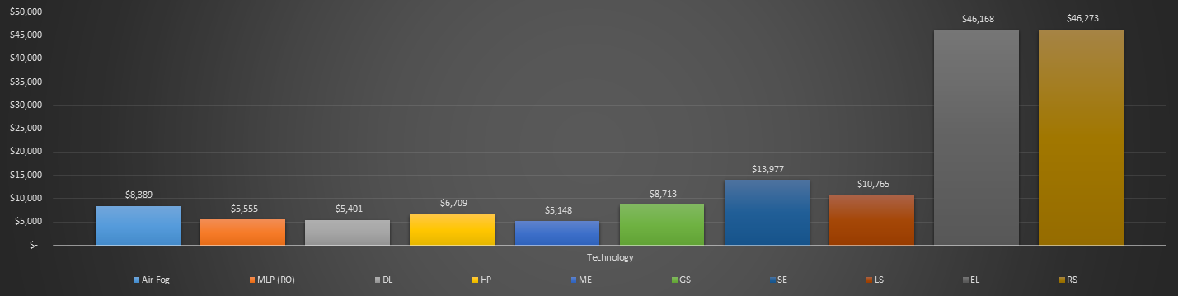
Salt Lake City example
40,000 CFM AHU in Salt Lake City, Utah.
Cold snowy winters
Relatively wet shoulder seasons
Dry, hot summers

Slide 52
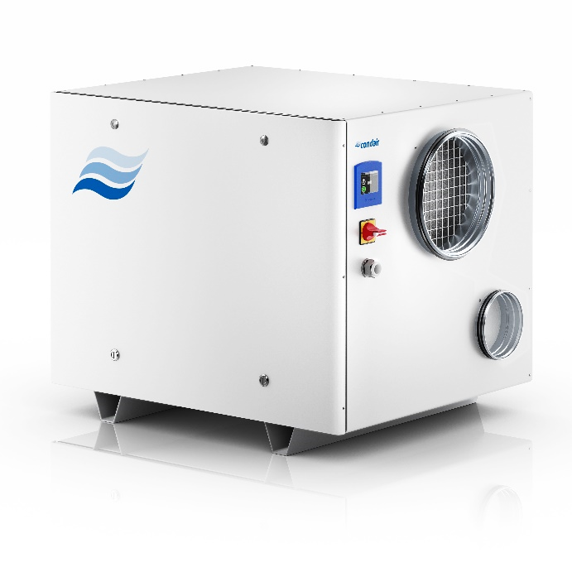
NEW! Condair DA

Slide 53
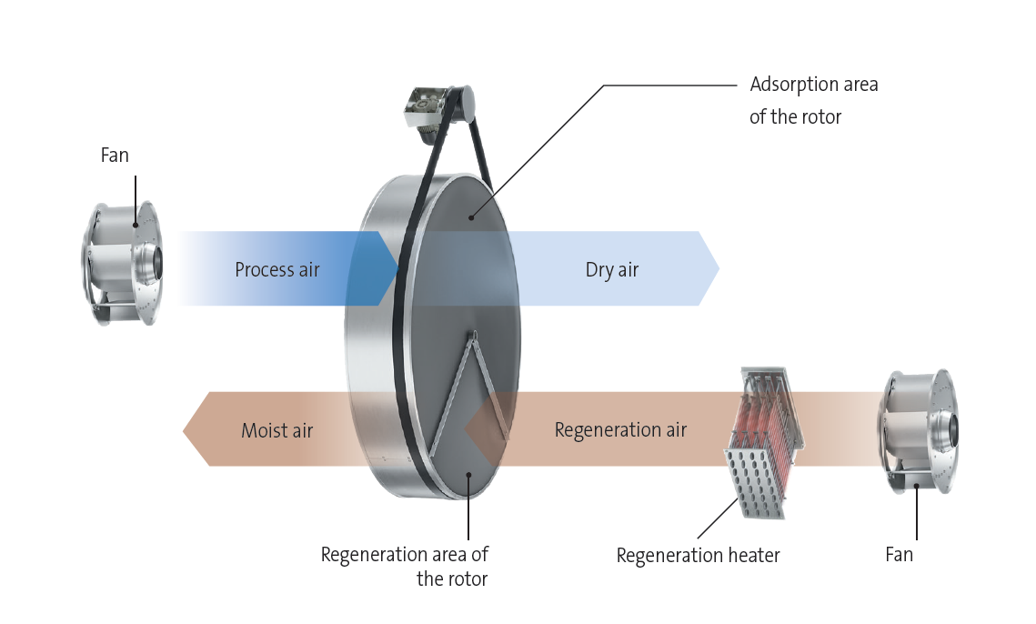

NEW! Condair DA
Two types of dehumidifiers:
Condensing
Desiccant

Slide 54

NEW! Condair DA
Condensing dehumidifiers
Desiccant dryers
23 32 41 50 59 68 77 86 95
°F

Slide 55

NEW! Condair DA
Drying Process
1. Process Air
2. Dry Air (ideal process)
3. Dry Air (rotor heat transfer)
Reactivation Process
1. Regeneration Air
2. Reactivation Heater
3. Wet Air
3
2

Slide 56
NEW! Condair DA
Sector | Area of application | Relative Humidity | Temperature (°F)
Antiquities | Storage and repair | 45-50% | 71-78
Automotive | Manufacturing | 45-55% | 75-80
 | Car spraying plant | 40-50% | 75-80
Library | Book Warehouse | 40-50% | 73-80
 | Reading rooms | 35-55% | 73-80
Hospital | Operating room | 50-60% | 75-82 (64-70)
 | Patient room | 40-50% | 71-75
 | Nursery | 50% | 78
Furniture industry | Veneer storage | 50-60% | 62-67
 | Furniture production | 40-50% | 67-71
 | Manufacturing of clamping plates | 50-55% | 57-71
 | Wooden furniture storage | 50-55% | 57-67

Slide 57
NEW! Condair DA
Sector | Area of application | Relative Humidity | Temperature (°F)
Fashion | Tannery | 65-70% | 53-71
 | Storage of furs | 50-60% | 44-53
 | Spinning mill / silk | 50-65% | 71-80
Museums | Paintings | 40-55% | 67-78
Paper industry | Storage | 50-60% | 62-71
 | Rotary printing | 60% | 71-80
 | Screen printing | 50-60% | 75-78
 | Processing (binding/cutting) | 50-60% | 75-89
Pharmeceutical | Raw material storage | 30-40% | 73-84
 | Penicillin production | 60% | 80
 | Tablet press | 35-50% | 73-84

Slide 58
NEW! Condair DA
Sector | Area of application | Relative Humidity | Temperature (°F)
Clean room technology | Electronic equipment for microscopy | 40-45% | 75
 | Wafer production | 40-45% | 75
Confectionery industry | Storage of yeast | 60-75% | 35-44
 | Flour storage | 50-60% | 62-80
 | Chocolate storage | 60-65% | 67-73
 | Dried fruit storage | 50% | 53-58
 | Sugar storage | 35% | 80
Tobacco Inudstry | Raw tabacco storage | 60-65% | 73-76

Slide 59
NEW! Condair DA
Features | Benefits
Insulated Casing as Standard | Allows for installation outside of cold areas Noise Reduction
PLC with touch screen | Service and Fault alarms, including log Modbus and other communication protocols available Andriod/Iphone app available
Self-regulating PTC heaters | Extremely safe, cannot overheat
Fully packaged unit | Fans installed inside for quiet operation
1-side service access | Allows for wall mounting Stackable units
UL certified | Only UL certified desiccant dryer on the market

Slide 60
NEW! Condair DA
Unit | CFM | Voltage | lbs/h | Casing | Rotor Size
DA – 300 | 294 | 208V/480V, 3P | 7.3 | 36in D x 48in W x 39in H | 450mm x 140mm
DA – 400 | 412 | 208V/480V, 3P | 12
DA – 600 | 589 | 208V/480V, 3P | 16
DA – 800 | 824 | 208V/480V, 3P | 22 |  | 650mm x 140mm
DA – 1400 | 1413 | 208V/480V, 3P | 30
DA – 2000 | 2001 | 208V/480V, 3P | 32
DA – 2400 | 2354 | 480V, 3P | 44 |  | 650mm x 200mm

Slide 61

NEW! Condair DA

Slide 62

NEW! Condair DA

Slide 63

NEW! Condair DA
Desiccant dryer place in the dehumidified room
Risk of infiltration, due to lack of overpressure
With low infiltration rates, very efficient dehumidification concept.
Common installation for applications with low
dry air volumes.
Very dry values achievable
<0,5 g/kg.
Examples:
Storage, Production
Test rooms, Freezer Storage
1. Pressure neutral desiccant in-room dehumidification
Room
Sensor
Process
Outlet
Process
Inlet
Reactivation
Inlet
Reactivation
Outlet

Slide 64

NEW! Condair DA
2. Pressure neutral desiccant dehumidification
Desiccant dryer place outside the dehumidified room
Risk of infiltration, due to lack of overpressure
With low infiltration rates, very efficient dehumidification concept.
Common installation for applications with larger
dry air volumes.
Very dry values achievable
<0,5 g/kg.
Examples:
Storages, Production hall,
Test rooms
Room
Supply Air
Exhaust Air
Sensor
Process
Outlet
Process
Inlet
Reactivation
Inlet
Reactivation
Outlet

Slide 65

NEW! Condair DA
Fresh air supply gets mixed in to the system
Fresh air is creating an overpressure inside the room and eliminates infiltration
Fresh air rates given by the customer
Fresh air is a constant moisture load
Almost not doable with condensing
dehumidifiers
Examples:
Cleanrooms, Packaging rooms
Productions, Laboratories
3. Desiccant Dehumidification with Fresh Air

Slide 66

NEW! Condair DA
Dry Air = Total air throughout though the room
constant loss of dehumidified air
Very high moistures loads in summer and resulting
high energy consumption.
Use in contaminated air (dust, fumes)
Not possible with condensing dehumidifiers,
due to operation limits
Examples:
Silos, Laboratories
Dedicated machine housing
4. 100% Fresh Air Dehumidification

Slide 67

NEW! Condair DA
Dry Air amount = Process airflow
Control to specific moisture and temperature values for production processes, including pre and post-treatment of the process air.
Very important to specify the moisture in abs. humidity g//kg,
since rH is temperature dependent. Alternatively °F dew point is also
possible.
Examples:
Pharmaceutical-, Chemical-,
Food-Industry
5. Process Dehumidification

Slide 68

NEW! Condair DA
 |  |  | Checklist for air dehumidification
Detailed description of the intended use:
✅ | What should be dehumidified? Detailed description of the process, resp. the moisture problems.
General information:
✅ | Location of the facility (meteorological data)? Other conditions for regeneration- or outside-air?
✅ | Room volume?
✅ | Current conditions inside the room (temperature and humidity)?
✅ | Target conditions for the room (humidity and temperature)?
External moisture load:
✅ | Existence of an mechanical ventilation system? If existent, CFM and inlet conditions.
✅ | Information about the tightness of the room/facility (air tight - middle - leaky) , in order to estimate the air infiltration. Are there any openings like doors and/or windows which get opened frequently? If yes, size of the opening and duration. Any other considerable Infiltration sources?
Internal moisture load:
✅ | Number of people inside the room?
✅ | Intensity of the working condition (low, middle, heavy)?
✅ | Any other moisture loads? E.G. open water surfaces, cleaning work, moisture load through production process
Other important details:
✅ | Are there any aggressive chemicals inside the room air (chlorine, detergents, ozone, acids, …)? If present, concentration.
✅ | Are there any alternative heat sources available (warm water, stream, etc.)? Potential energy savings for adsorption dryers. ** this will be used when we launch additional modules **
✅ | Available power supply? (e.g. 480V 3 phase 60 Hz)
✅ | Special filtration requirements?

Slide 69


NEW! Condair DA

Slide 70
Thank you for joining!
Controlling COVID-19 Through
Indoor Humidity Management
with Graham Holmes, Dr. Stephanie Taylor, and Thomas Klein

